Slide 1

W F!
Your Pets Deserve the Best
Nafis Abeer, Justin Lam, Chase Maivald, Rajiv Ramroop, Daniel Shimon

Slide 2
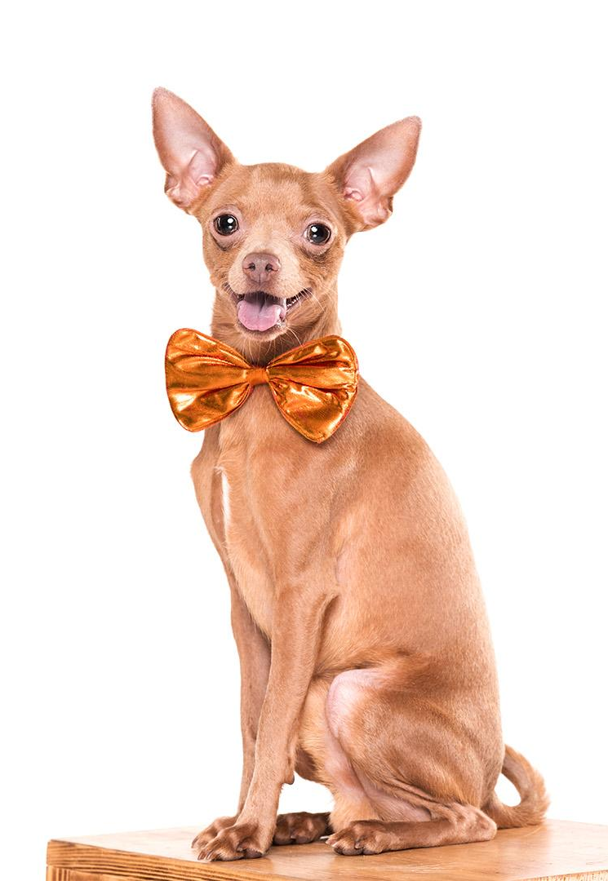
Value Proposition
For dog owners who want a reliable social media application to represent the members of their own dog community
WOOF is a app that pairs with our custom-made dog tag allowing owners to easily track and receive recommendations based on their pet’s activities
Unlike Patch Pets & Petzbe, our product will utilize ML Algorithms to process data from our tags
Essentially...

Slide 3
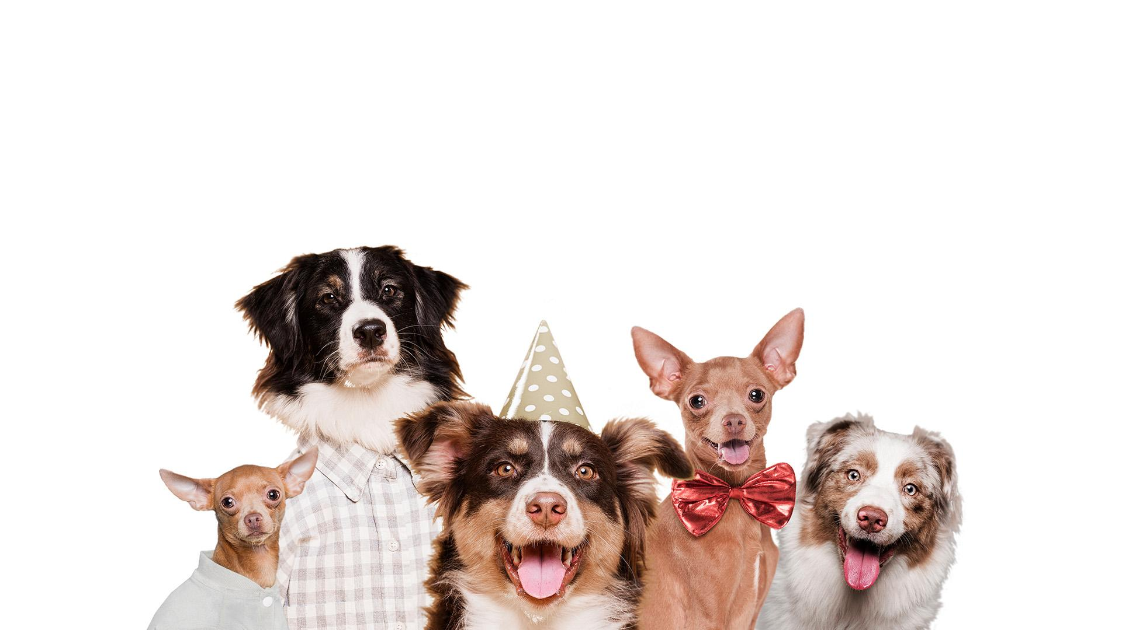
We Offer you an App that lets your dog choose their Own friends

Slide 4
W F!
ProJect Statement
The goal of our product is to give users quick and easy insight into which dogs your dog enjoys playing with and where to find them using software, hardware, and Machine learning
Societal Impact
The proposed product encourages users to connect their dogs to ideal playmates, improving the overall health and wellbeing of all dogs involved. It also promotes social interaction between user.

Slide 5
W F!
Why SHould you care?
Technical Solution
Unique (no social media app on the market that utilizes ML to match dogs)
Our app prioritizes dog-dog interactions instead of human-human interactions
Fully Functional Front-end application
ML algorithms
Pretrained Base Model (Computer Vision)
SVM to consider features from sensors and user input
AWS E2C Server for computations
Firestore/AWS S3 database
Custom dog tag with sensors

Slide 6
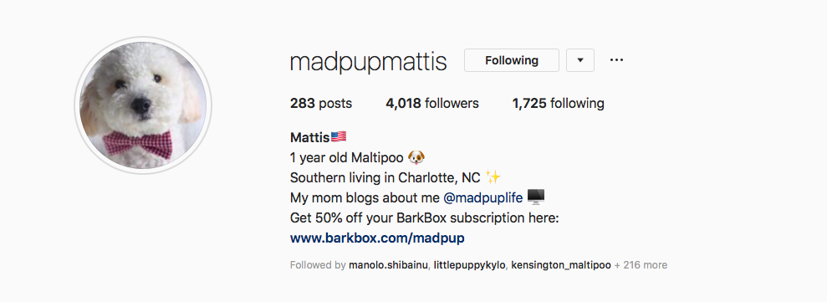
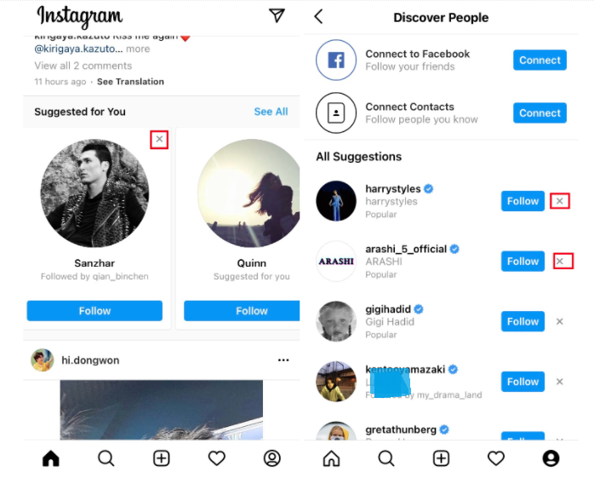
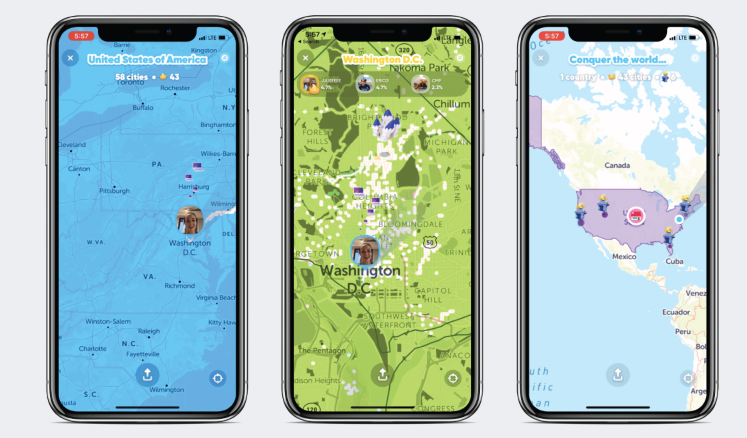

Slide 7
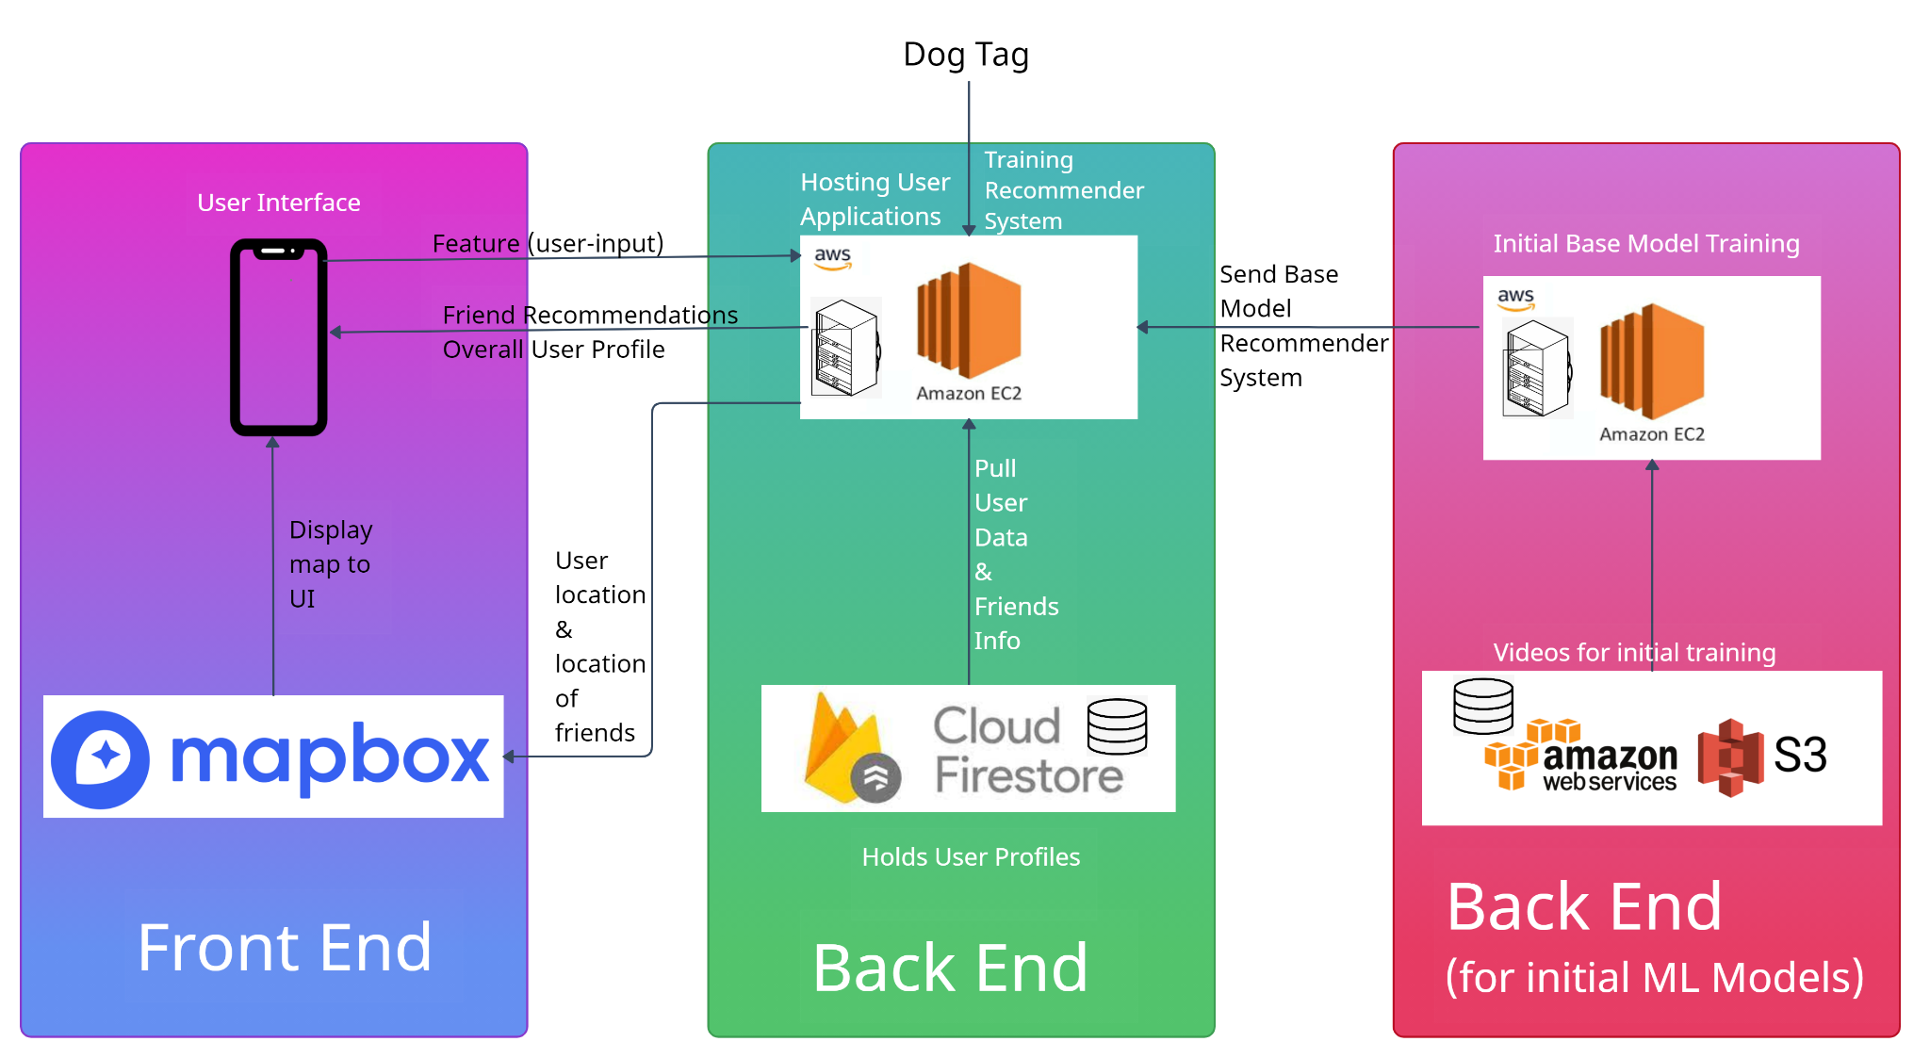

Slide 8
Deliverables
Machine Learning Algorithms:
Pre-trained base model using videos of dogs interacting, utilizing Computer Vision
Utilizing SVM to consider added features such as motion from accelerometer values, dogs barks, and user input to analyze dogs’ interactions live
A social media app with:
Interactive map
History page
Friends page
Profile page
A dog tag capable of:
Always locating dog
Tracking dog’s motions via accelerometer
Record dog’s barks via microphone

Slide 9

thanks
Any Questions?

